Slide 1
Menon Fellowship
Final Deliverable
(CommonLit Team 02/04)
Notes:
Introduction
UI Prototype
Ideal user flow
First Time User Interaction
Main Navigation Between Catalog and Downloads
Downloading and Removing Downloads
Reading
Answering Questions
Sharing texts or passages
Offline Version
Development Status
Expo App to Push Updates to
Features Completed
Features in Progress
Future Roadmap / Extra Features
Proposed features

Slide 2
Problem Identification
Needs of CommonLit Users (Latin American teachers and students):
Need to access CommonLit’s catalog of reading materials
Need to do so without reliable internet connection
Need to read content from CommonLit primarily with mobile devices
CommonLit Internal Needs:
Need to be able to track usage analytics of the mobile app solution
Goal: Build a mobile app that lets Latin American teachers and students access CommonLit’s catalog with weak and inconsistent internet connection.
Notes:
Problem Statement
CommonLit user needs
CommonLit’s internal needs

Slide 3
Research and Stakeholder Interviews
CommonLit Feedback
Need to primarily cater to phone devices rather than tablet devices
Need to specifically track number of “uses” of each text in database
CommonLit Espanol Team Feedback
Need to simplify filtering UI as much as possible to make it intuitive and easy
Need to help teachers leverage the app alongside platforms they already use, such as Whatsapp
Notes:
Research and Stakeholder Interviews
Independent Research
UI study
Background research on Latin American Education
Pamela Feedback
CommonLit Team Feedback
Streamline filter system
Have some sort of way where users can share texts or passages with each other

Slide 4
Most Essential Features
Detect Internet access and get CommonLit’s current catalog when connected
Need addressed: Users need to access CommonLit catalog
Download texts to local storage
Need addressed: Users need to access texts without reliable internet
Open CommonLit texts with HTML data formatted for devices
Need addressed: Users need to read texts primarily on mobile phone devices
Notes:
Essential Features List
Detect internet access to gather catalog
Download texts locally
Open texts with formatted html
Open reading comprehension questions with formatted HTML
Track events like downloads and store in an external database
Deep linking texts for teachers and students to share

Slide 5
Most Essential Features (cont.)
Open reading comprehension questions with HTML data formatted
Need addressed: Users need to read texts primarily on mobile phone devices
Track events like downloads or text reads and store in an external database
Need addressed: CommonLit needs to keep track of “uses” of texts in an external database
Configure button to share deep links to texts that other users can open
Need addressed: Users need to augment existing apps for teaching, like Whatsapp

Slide 6
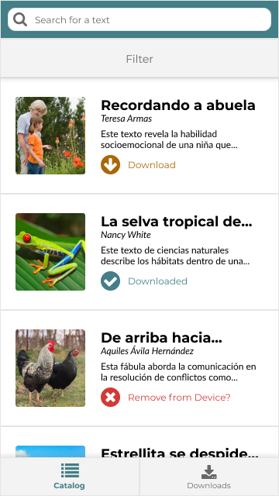
UI Prototype (Viewable here)
Splash Screen prompting grade and genre
Catalog Tab, auto updates with wifi access
List Item for each text retrieved
Background info and cover images
Download and Delete Buttons
Filter System and Search Bar
Download Menu with only downloaded texts
Notes:
UI Prototype
Ideal user flow
First Time User Interaction
Main Navigation Between Catalog and Downloads
Downloading and Removing Downloads
Reading
Answering Questions
Sharing texts or passages
Offline Version

Slide 7
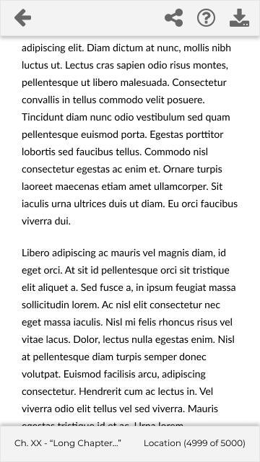
UI Prototype (Cont.)
Formatted HTML Text
Formatted Comprehension Questions
Download Link
Share Text Button for Whatsapp
Return to Menu
Notes:
UI Prototype
Ideal user flow
First Time User Interaction
Main Navigation Between Catalog and Downloads
Downloading and Removing Downloads
Reading
Answering Questions
Sharing texts or passages
Offline Version

Slide 8
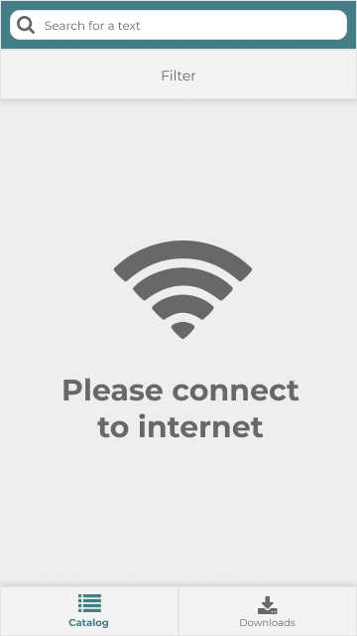
UI Prototype (Offline Fallbacks)
Fallback Screens for no wifi situations
Catalog selection cached from last visit
Downloaded books accessible offline
Notes:
UI Prototype
Ideal user flow
First Time User Interaction
Main Navigation Between Catalog and Downloads
Downloading and Removing Downloads
Reading
Answering Questions
Sharing texts or passages
Offline Version

Slide 9
Development Status (Prototype on Expo)
In Progress
Completed
Open reading questions with formatted HTML data
Detect Internet access and get CommonLit catalog
Track user events on texts and store in a database
Open CommonLit texts with formatted HTML data
Share button to share texts over Whatsapp
Download texts to local storage
Notes:
Development Status
Current Version of App Prototype on Expo
Features in Progress
Features Completed

Slide 10
Development Roadblocks
Shifting Personnel
Unintended IDE Issues
Overcoming Developer Bias
Continuing Development in spite of API Loss
https://github.com/nguyensp/MenonAccess
Notes:
Migration into Expo

Slide 11
Future Features Roadmap
Key Accessibility Features
Adjustable text-to-speech reading of text
Adjustable font, spacing, font-size settings for text display
Dark Mode / Night Mode
Reading App Quality of Life Features
Track passages that have already been read
Favorite texts to read later
Add notes and highlights
Notes:
Future Roadmap / Extra Features
Proposed features
Accessibility Features
Hear a reading passage read aloud
Adjust text font size
Dark Mode
Quality of Life Features
Track passages already read, High accuracy return to last read passage
Favorite texts to read later
Add notes and highlights

